Slide 1
Coast or Trough?
Joren Janzing

Slide 2
Content
Heat Advection
Alessandro

Slide 3
Recap
Composite of temperature seems to show coastal pathway, both during warm and cold events

Slide 4
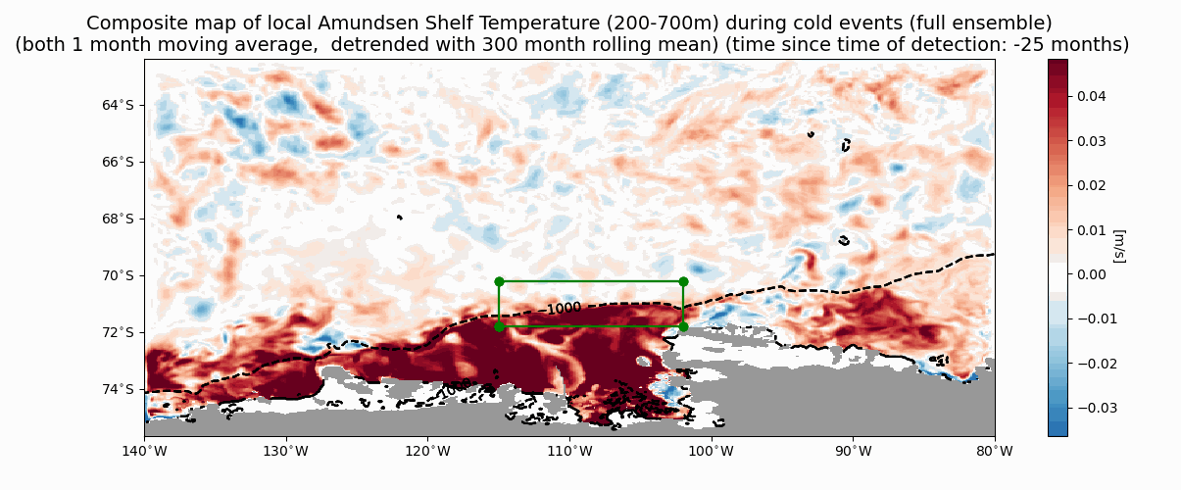

Slide 5
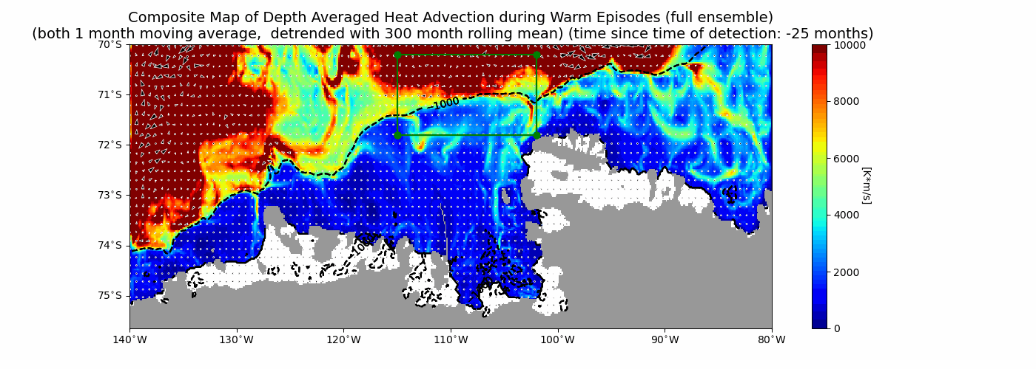
Old method does not work that nicely unfortunately…..

Slide 6
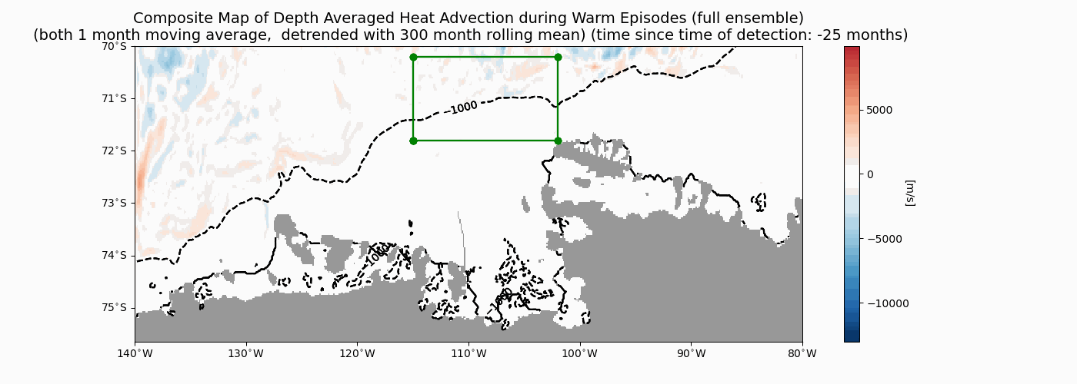
New method seems to suggest main influence of troughs.

Slide 7
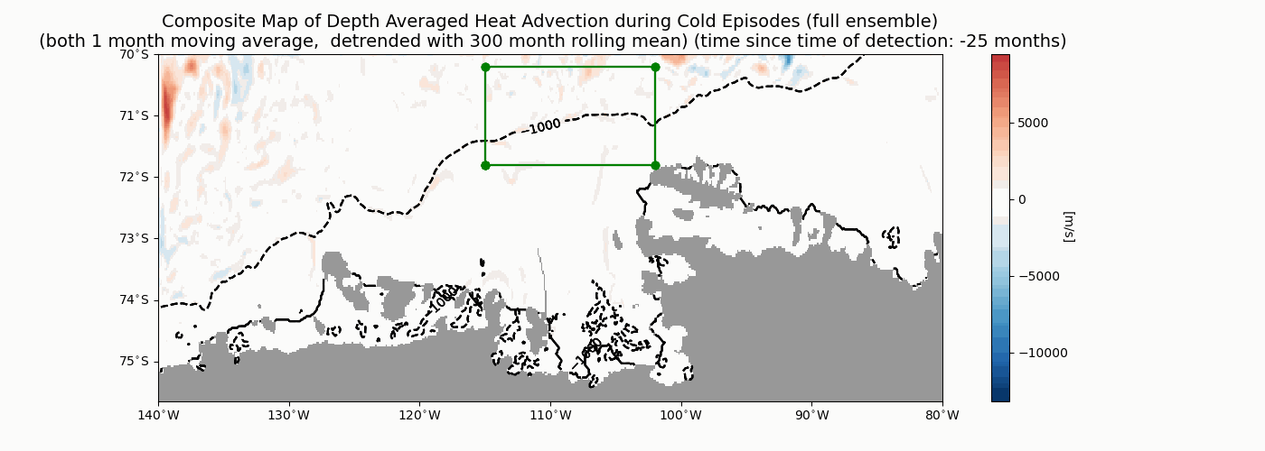

Slide 8
Do we see the same in the advection?
Composites
Transects?
Individual members?
Coupling to wind, ice and temperature?

Slide 10
Some updates for Alessandro
Joren

Slide 11
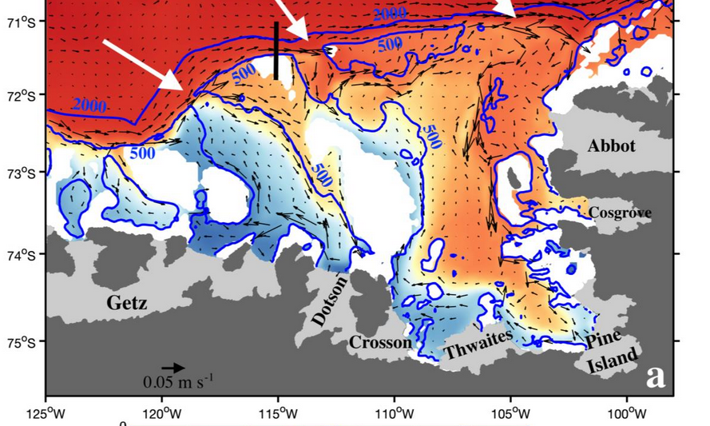

Slide 12
Ensemble Mean

Slide 13
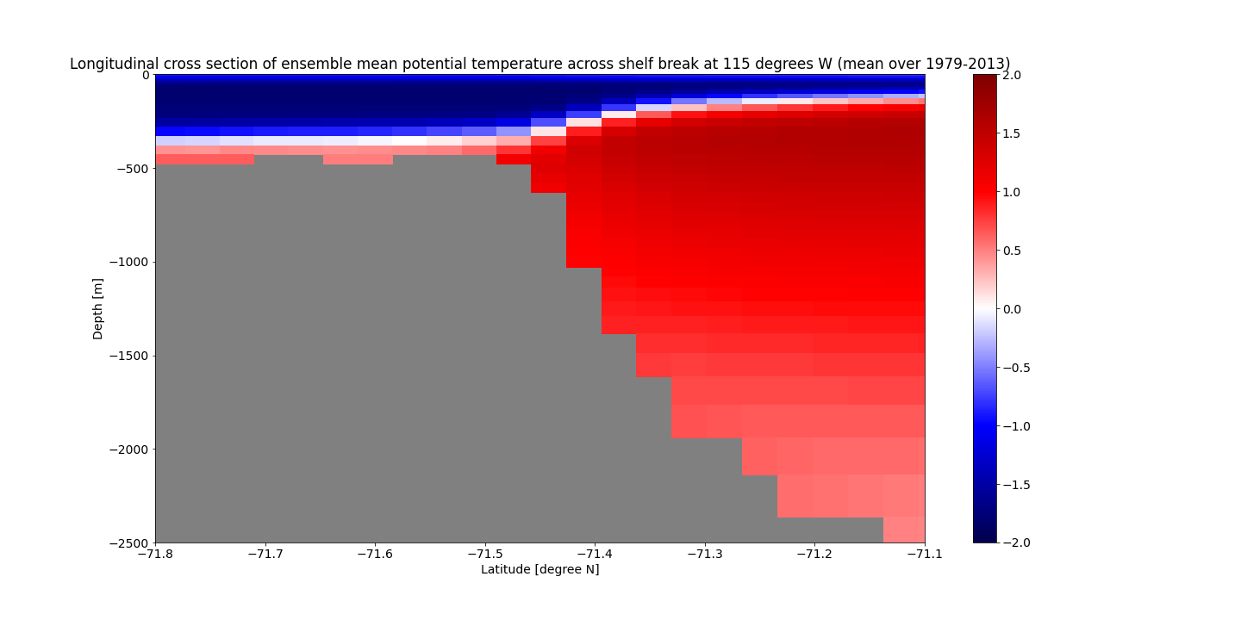
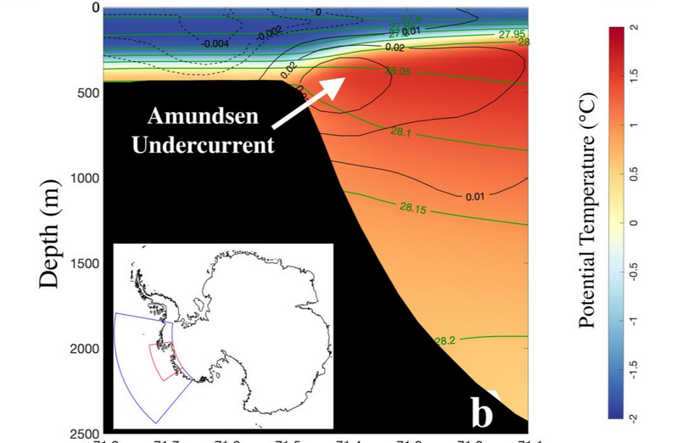
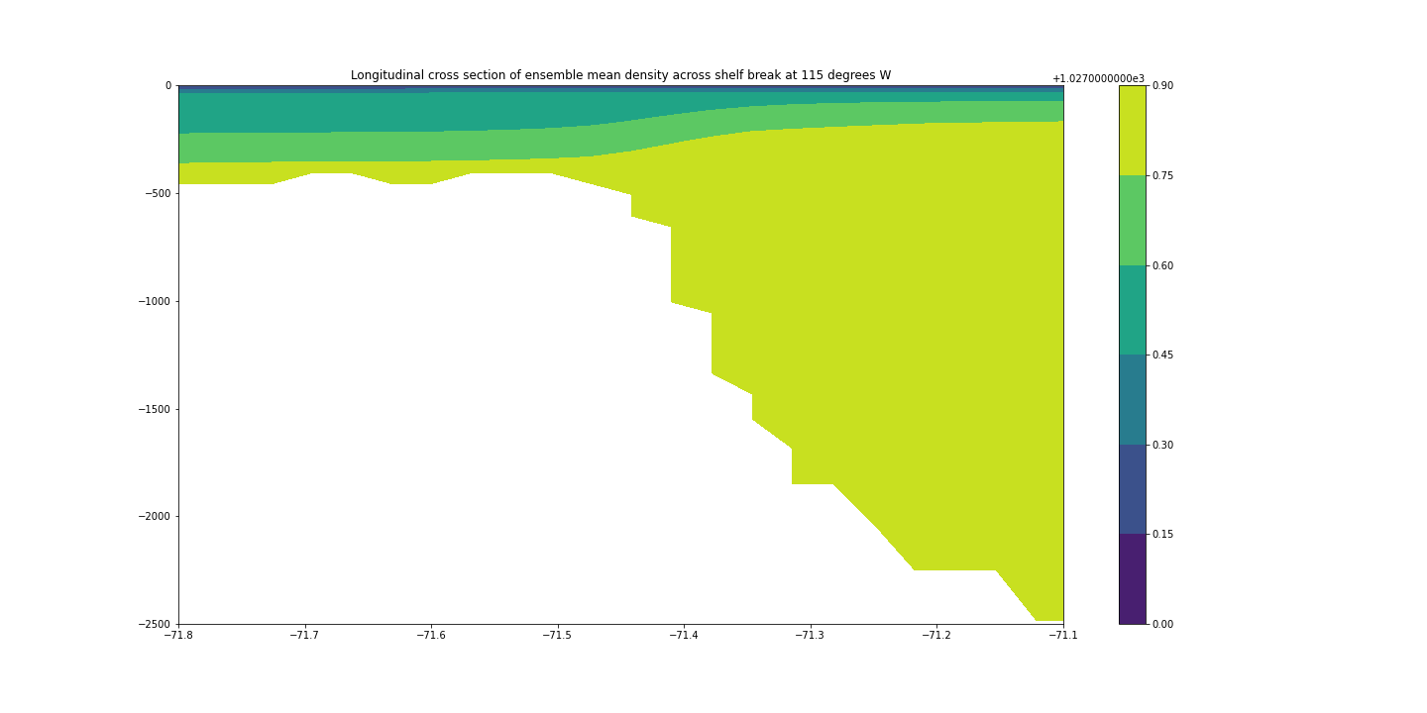

Slide 14
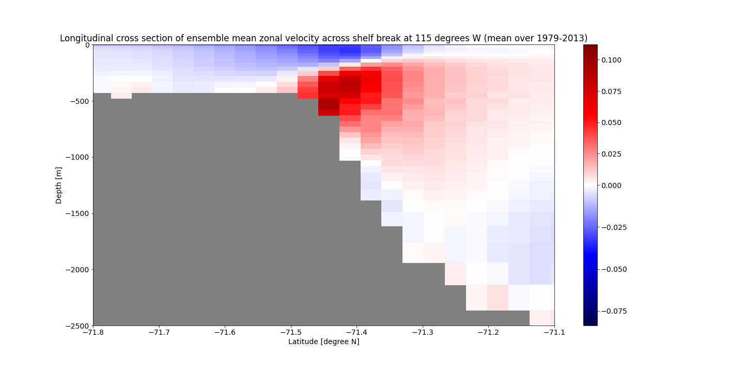

Slide 15
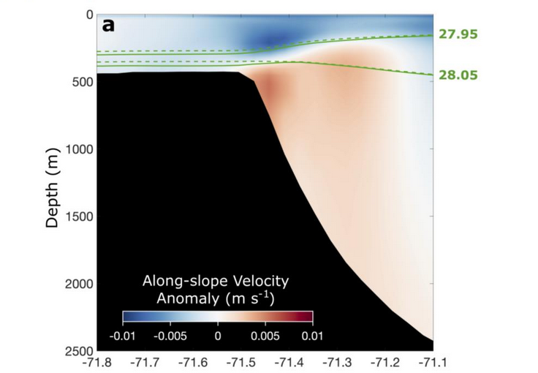
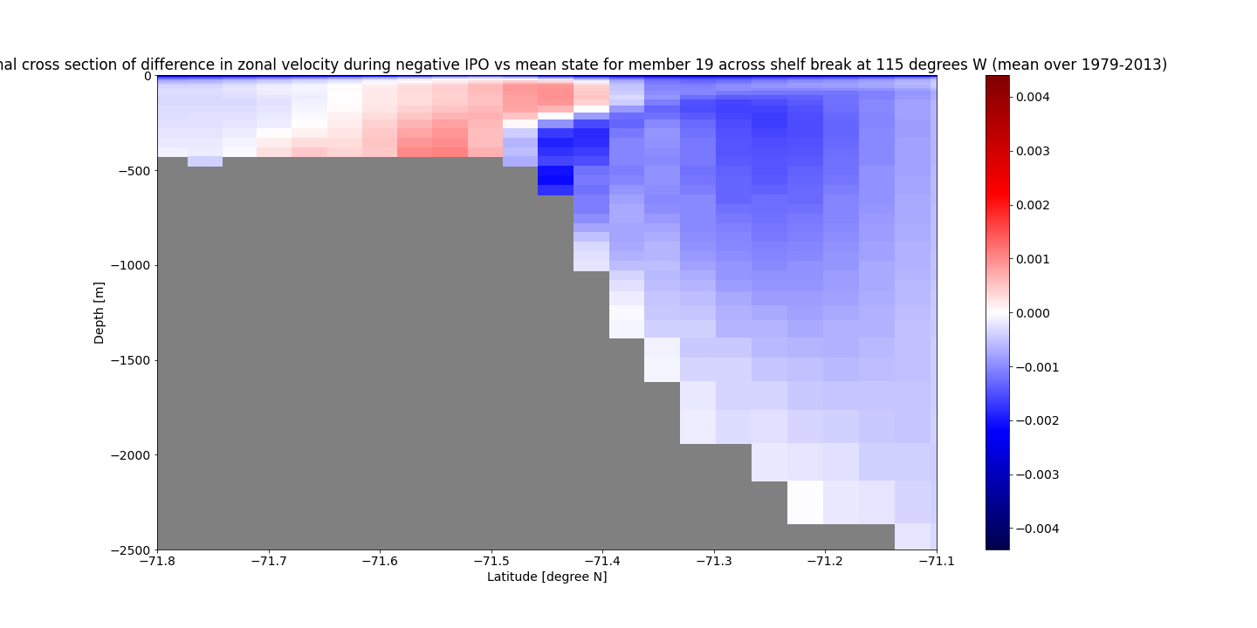

Slide 16
Member 19
More baroclinic

Slide 17
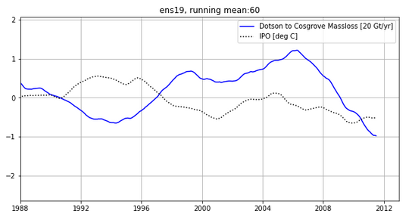

Slide 18
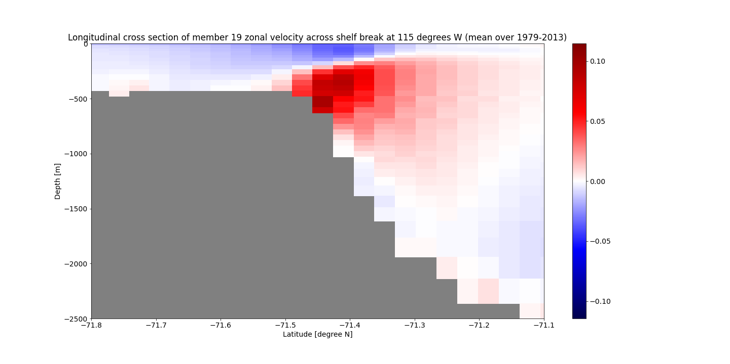

Slide 19
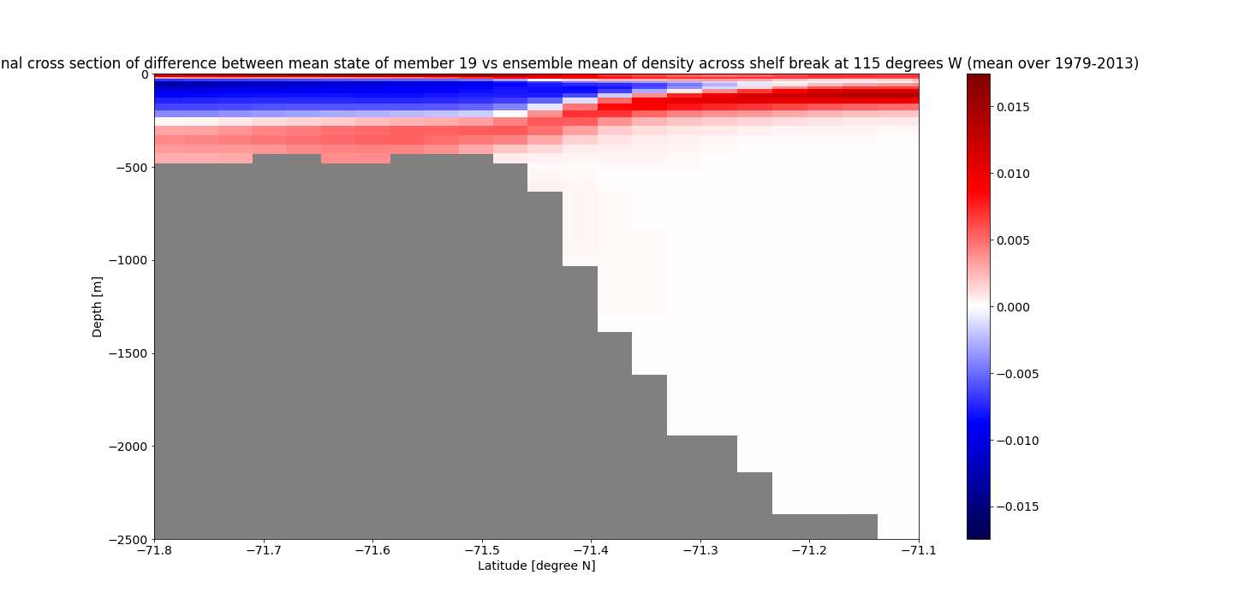

Slide 20
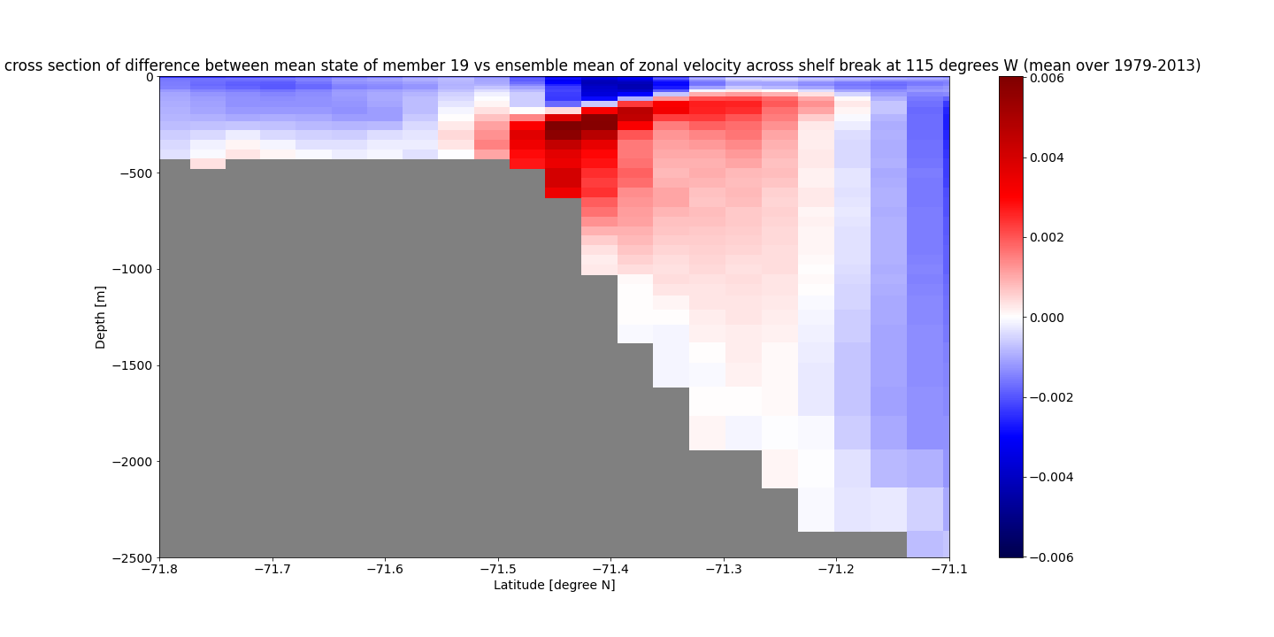

Slide 21
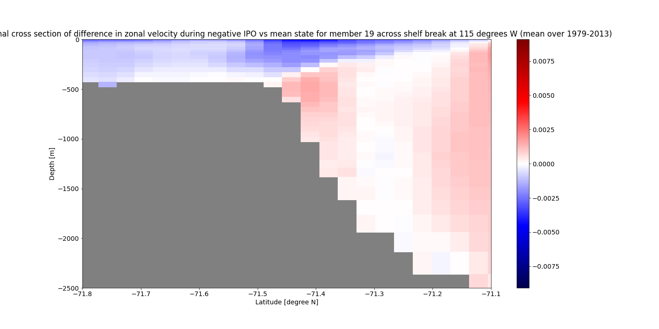

Slide 22
Member 1
More barotropic

Slide 23
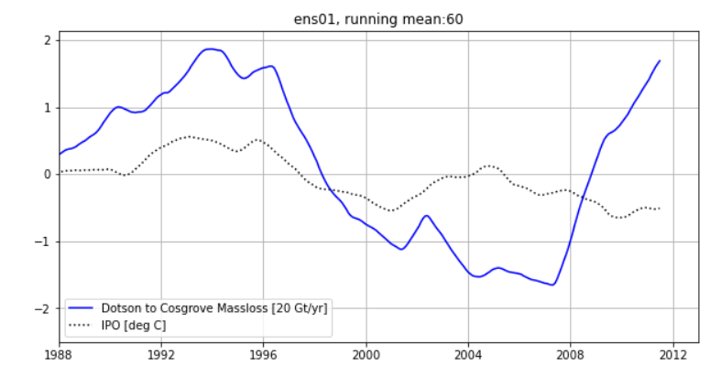

Slide 24


Slide 25
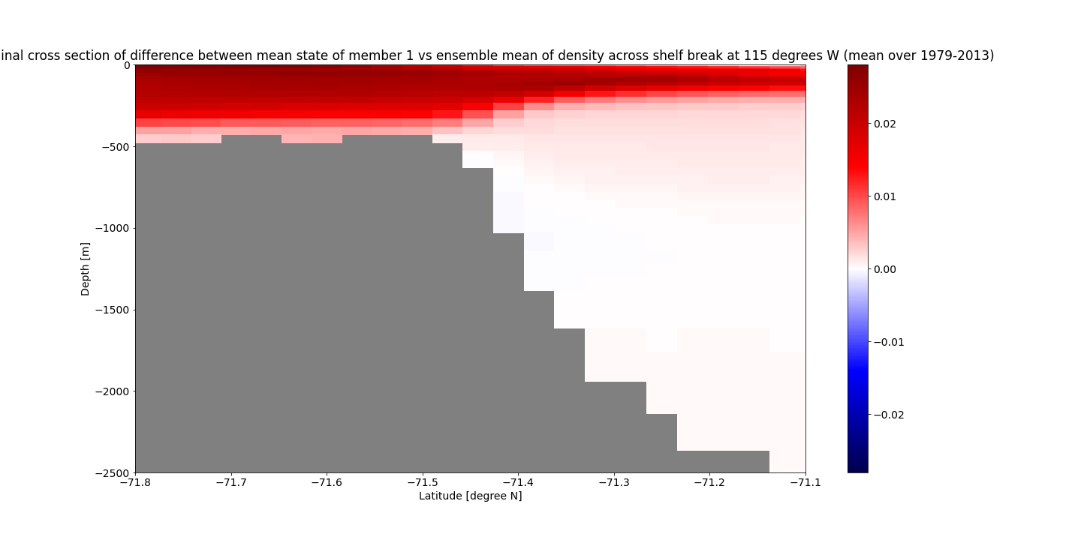

Slide 26
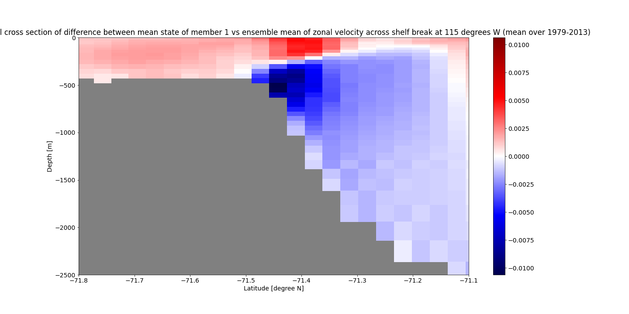

Slide 27
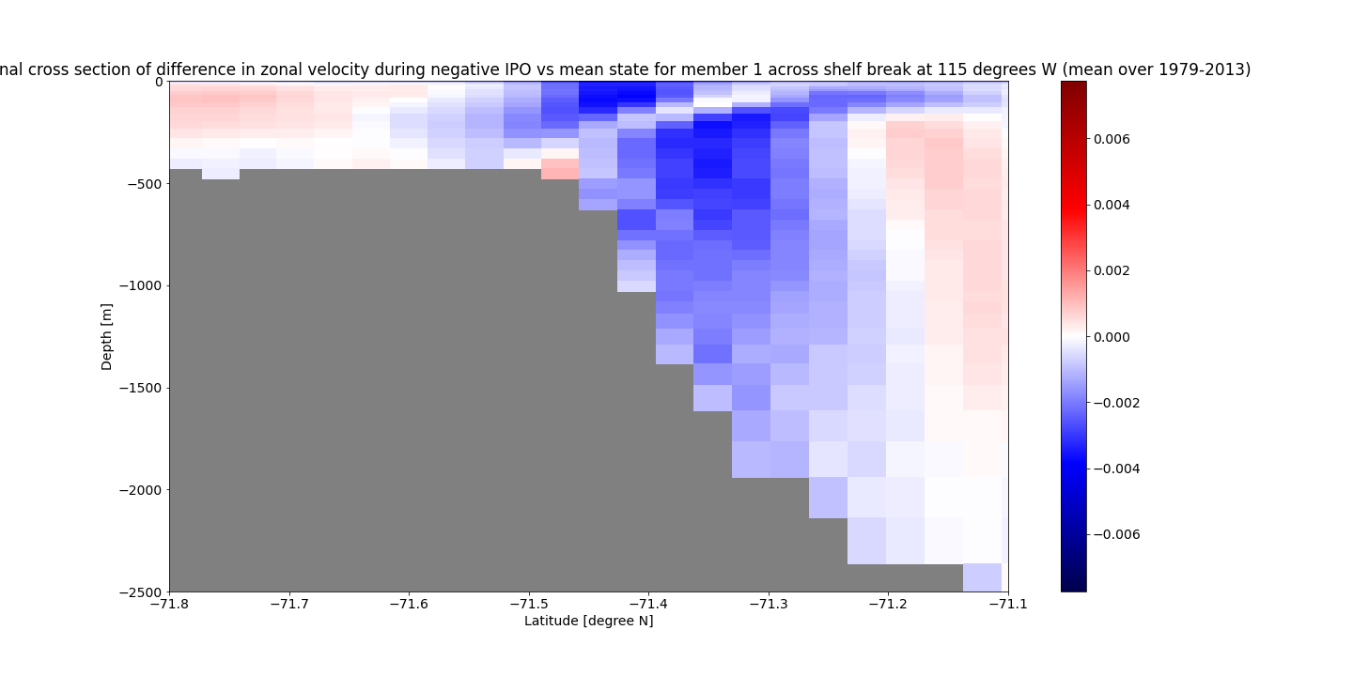

Slide 28
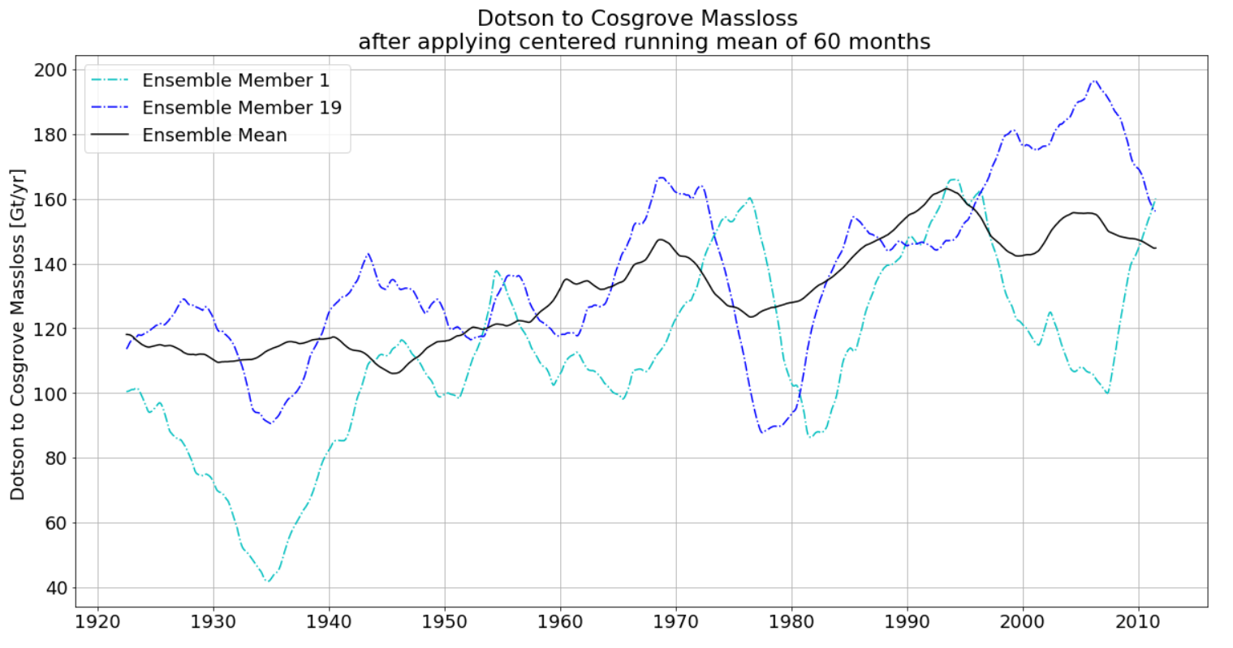

Slide 29
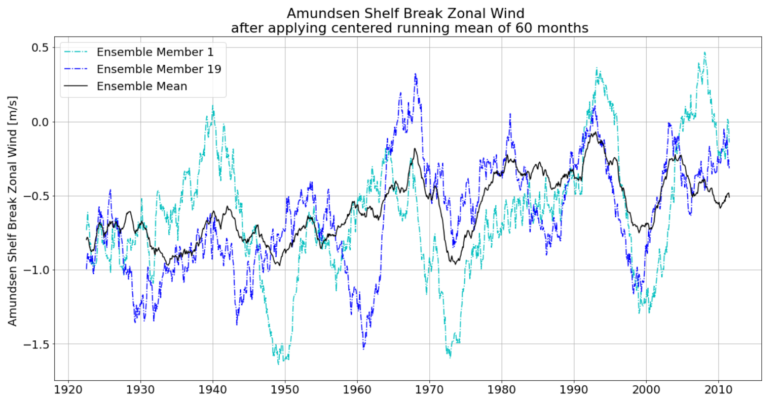

Slide 30
Extra
https://docs.scipy.org/doc/scipy/reference/generated/scipy.io.loadmat.html
plot_ua.py has examples
function interp_bilinear in interpolation.py
class NCfile in file_io.py, maybe
Send it by:
FTP
BAS onedrive

